Slide 1
Year 11
Parents’ Information/Study Skills
J Frew – Head of Faculty – Learning and Teaching

Slide 2
Home-School Partnership
Pupils
School
Parents

Slide 3
KS3 – KS4 Transition
Fewer subjects
2 Year Course
Controlled Assessment - part of final grade
Year 11 Modules – may be taken in some subjects in June 2018

Slide 4
Sixth Form Entry
Minimum Grade C in Maths and English
Minimum of 7 GCSE passes Grade C or better
including 3 GCSE B Grades – minimum 10 points
A*/A - 3 points, B – 2 points, C – 1 point
Grade A in a subject is best platform for A Level study

Slide 5
Targets
Our target is that pupils attain 7 A*/A – C grades
including English and Mathematics
Early in Year 11 teachers will discuss ‘Target Grades’ with their pupils.
Pupils should note these grades in their planners
Target grades will appear on reports alongside grade
pupil is currently attaining

Slide 6
Core Assessments and Reporting
3 reports per year
Based on Core Assessments which are closely linked to GCSE work
Data or Comment report
School monitors and intervenes as necessary
A good point for parental support and intervention

Slide 7
Organisation in Year 11
What’s new?
Move from exercise books to files in many subjects
Notes and handouts
Course content
Examination technique guidance
Assessments
Use file dividers
Files must be kept organised and looked after
This can be an issue with Year 11 pupils

Slide 8
Mindset and Motivation
Can you achieve more or do you believe you have a fixed ability?
Studies of the brain and human intelligence have proven your ‘ability’ is not fixed
Everyone can develop, change, grow and become ‘smarter’
Hard work will bring success – talent and natural ability are only a small part of story

Slide 9
Amazing Brains
All Year 11 pupils attend a session in November
Mindset – positive mindset
Study skills and revision techniques including planning for revision

Slide 10
Learning Environment
Effective study and revision requires correct environment
Quiet and calm workplace to facilitate concentration
Music can benefit some but distracts others…also depends on nature of task
You can’t study with a television on

Slide 11
Planning Your Time
Homeworks help to consolidate learning
Need to be independently reviewing notes and learning from start of Y11 onwards
Study and revision need to be planned
Should be part of a daily routine
Prioritise activities on weeknights and the weekend

Slide 12
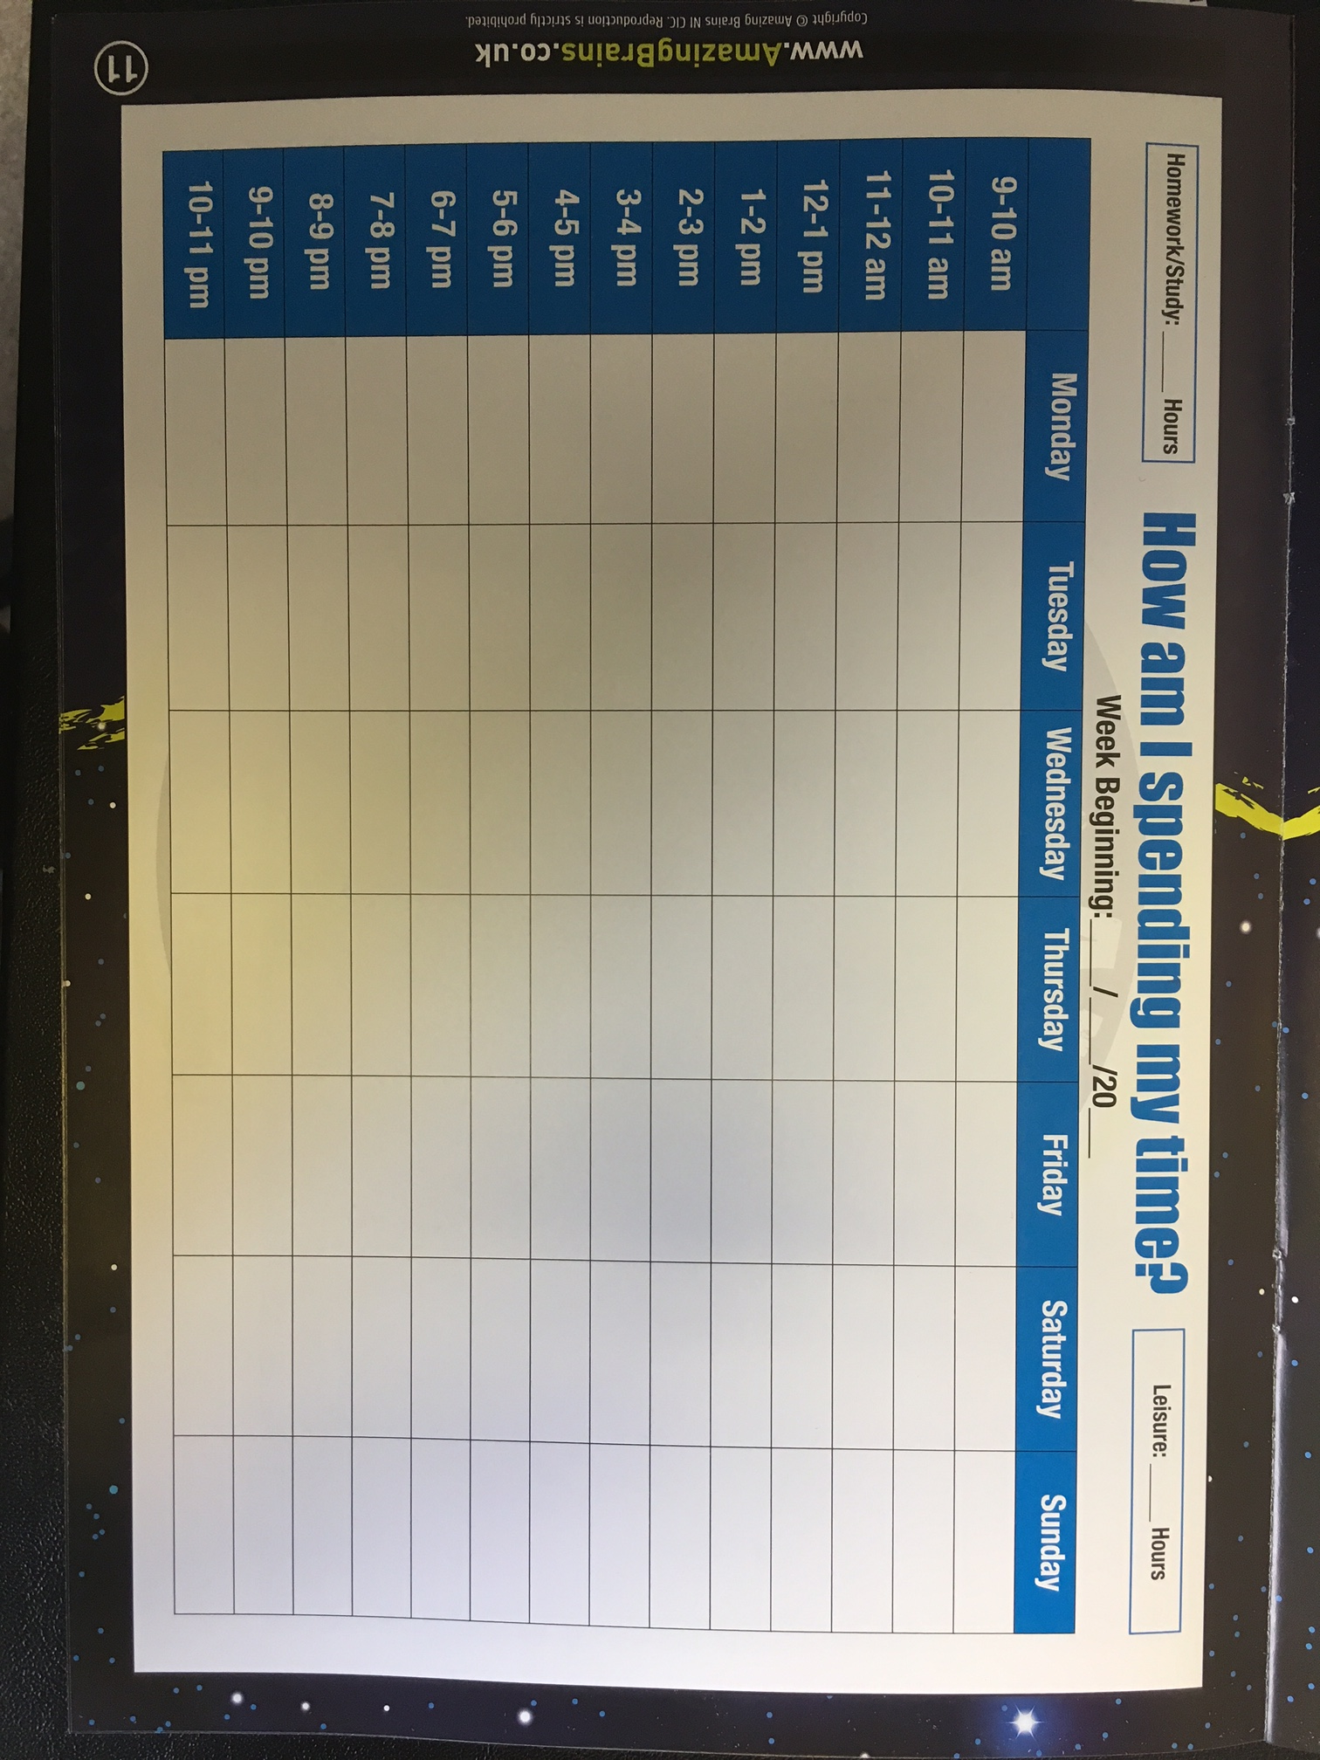

Slide 13
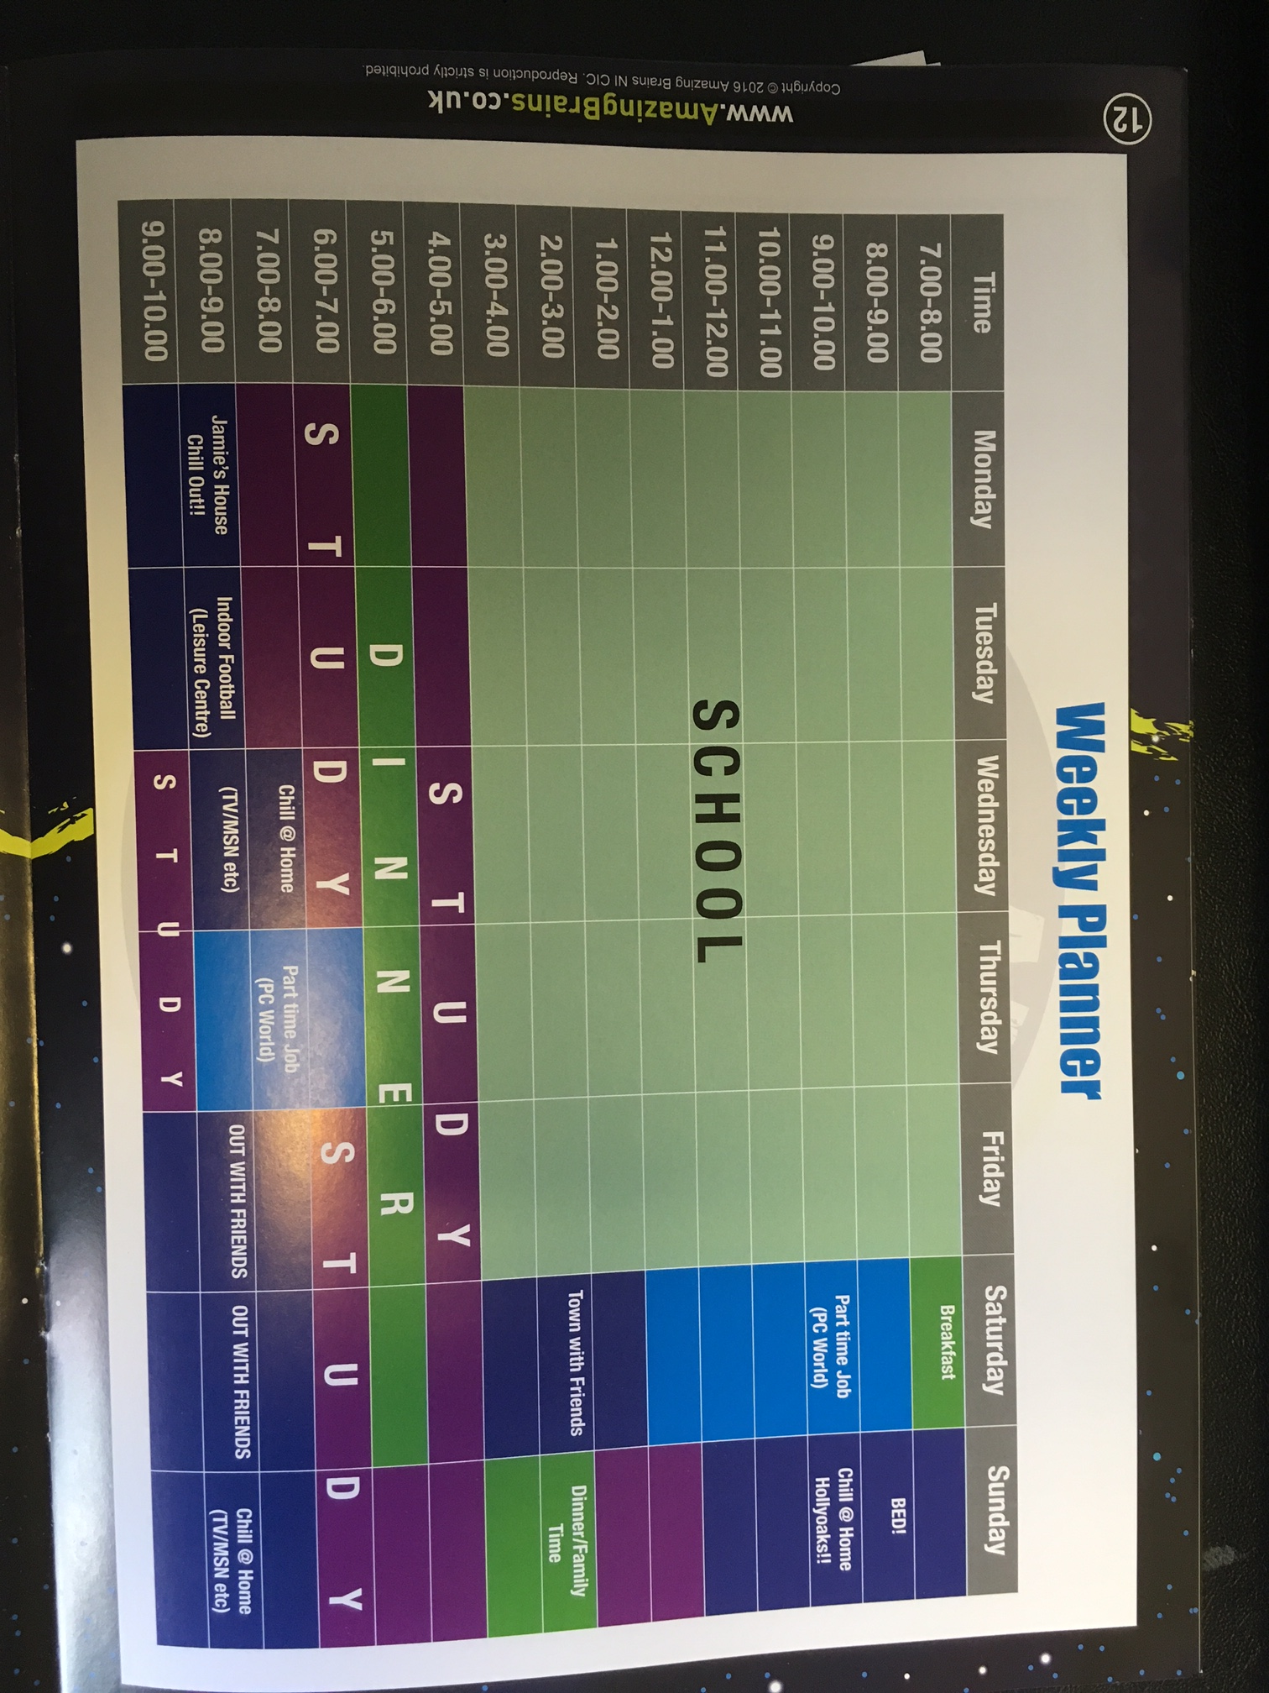

Slide 14
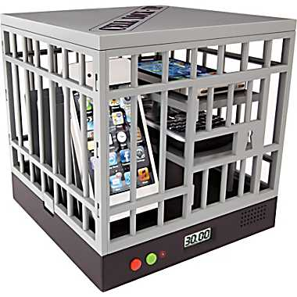
Phones/Tablets/Social Media

Slide 15
Active Learning
Learning is most effective when it is active not passive

Slide 16
Know the ‘Success Criteria’
Success Criteria provide guidance as to what students need to do to achieve in a task or subject area – helps to focus the LEARNING
At GCSE the success criteria are often linked to the techniques which need to be used in Controlled Assessment and examinations
http://ccea.org.uk/

Slide 17
Active Learning
Draw diagrams – visuals are very important and stimulating
Sketch mind maps, flow charts & spider diagrams of key topics
Come up with mnemonics
Revise with a friend/family: ask and answer questions

Slide 18
Active Learning
Make up a set of revision cards - with one main topic per card, each topic listing ideas or information for this topic.
Use colour to highlight key words and phrases
Write brief bullet point summaries of your notes
Repeat and say aloud
Use a variety of methods

Slide 19
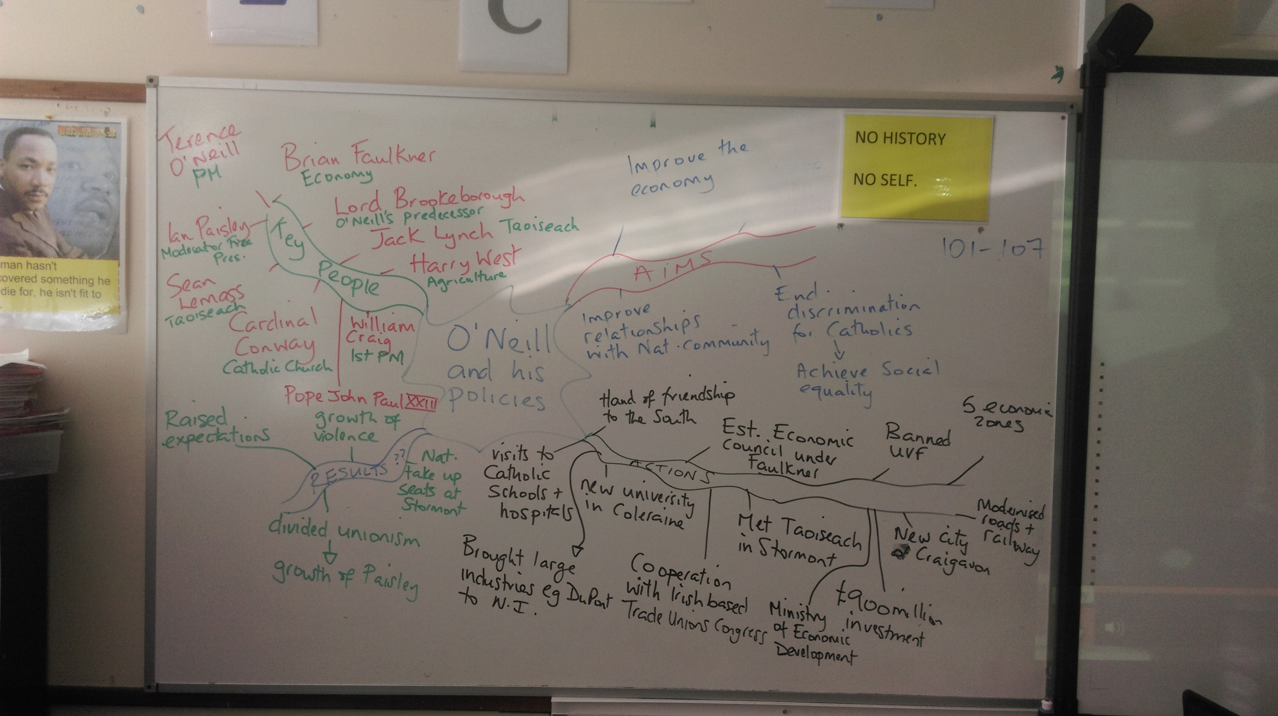

Slide 20
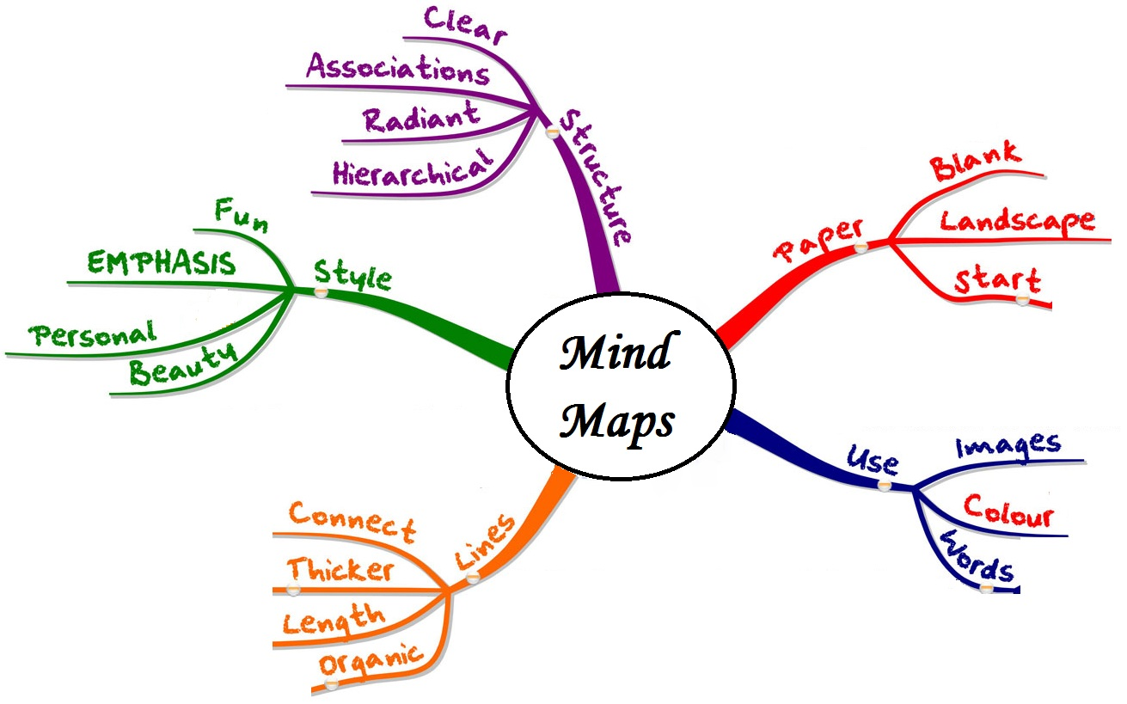

Slide 21
Post-Its
Use these to note down key points or questions you have
Are also good for sequencing activities etc

Slide 22
Test Your Learning
Mind maps, cards and notes are all good strategies….
However, you need to see how much you have learned – write down some questions and try to answer them, complete a past-paper, get your parents to ask questions

